Slide 1
Primer on Optimization January 2017
JJ Espinoza

Slide 2
What is optimization? – a way to maximize/minimize something given limited resources

Slide 3
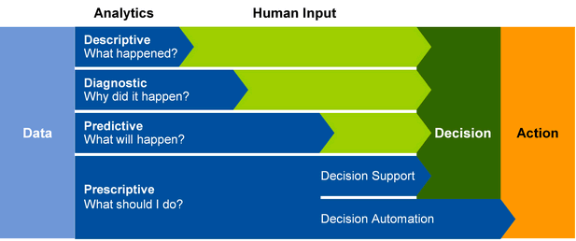
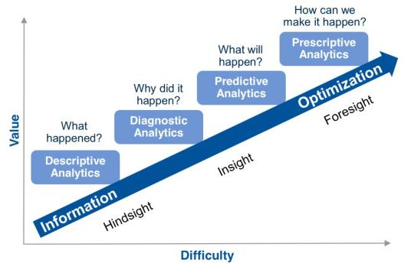
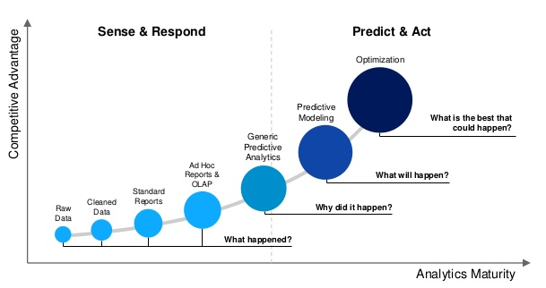
Why use optimization? – decision science (optimization) is high value analytics

Slide 4
What business questions in entertainment can benefit from an optimization approach?
Ad Sales
Marketing Allocation
Film Distribution
Theme Park Operations

Slide 5
Business Problem: Marketing Optimization
Background: The head of marketing for a major broadcast network received a report from world renowned consultants stating that the largest cost/revenue opportunity in her business was improving the efficiency of her marketing spending. Given your experience in statistics and optimization she calls you in her office and requests your help.
Your Task: The head of marketing has a few complex business questions she wants your help with:
Are we spending the right amount on marketing (increase/decrease budget)?
Are we investing in the right areas? If not, how do we rebalance our investments and what is the ROI?
Can you help me run through some likely scenarios we are sure to face next year?
Costs of TV advertising are going up by 20%, what is the optimal strategy then?
Costs of radio advertising are going down by 10%, what is the optimal strategy then?
Corporate is likely to cap our radio advertising at no more than 20% of our total budget, what will be the impact?
You are given: Data engineers and business professionals in the marketing department provide you with the following data
A data set with inputs (TV & radio ads) and outputs (ad sales), from which you will need to measure ad effectiveness
Marketing budgets for TV and radio individually as well as the total marketing budget for the network
The cost of an individual TV ad/radio ad

Slide 6
Mathematical Representation: Marketing Optimization
Objective Function
Matrices Going into Model
From the regression analysis on the data sales can be approximated by a function of ad inputs
Sales = 0.1883110 * Radio + 0.0457715 * TV + error
If we want to maximize sales...
Obj: maximize(Sales) = maximize(0.1883110 * Radio + 0.0457715 * TV + error)
Radio | TV
0.1883110 | 0.0457715
Constraints
Cost per Ad Unit:
Cost for TV = $10
Cost Radio = $30
Total Budgetary Constraints:
TV Budget Constraint = TV*$10 <= $400
Radio Budget Constraint = Radio*$30 <= $800
Total Budget Constraint = TV*$10 + Radio*$30 <= $1000
Radio | TV | Value
0 | 10 | 400
30 | 0 | 800
30 | 10 | 1000

Slide 7
Graphical Representation: Marketing Optimization
Total Budgetary Constraints:
TV Budget Constraint = TV*$10 <= $400
Radio Budget Constraint = Radio*$30 <= $800
Total Budget Constraint = TV*$10 + Radio*$30 <= $1000
TV
TV = 100
Radio = 27
Radio = 20 TV = 40
Radio = 27 TV = 40
TV = 40
Converted via Algebra:
TV Budget Constraint = TV <= $40
Radio Budget Constraint = Radio <= $27
Total Budget Constraint = TV <= $100 - Radio*$3
3
Z
2
4
Radio = 27 TV = 19
1
5
Radio = 33.3
Radio
Point 1:
Objective Value = 0.1883110 * 0+ 0.0457715 * 0 = 0
TV constraint = 0 <= 40
Radio constraint = 0 <= 27
Total Budget constraint = 0 <= 100 – 0*$3
Point 2:
Objective Value=0.1883110 *0 + 0.0457715*40 = 1.83
TV constraint = 40 <= 40
Radio constraint = 0 <= 27
Total Budget constraint = 40 <= 100 – 0*$3
Point 3:
Objective Value = 0.1883110 * 20+ 0.0457715 * 40 = 5.6
TV constraint = 40 <= 40
Radio constraint = 20 <= 27
Total Budget constraint = 40 <= 100 – 20*$3
Point 4:
Objective Value= 0.1883110*27 + 0.0457715*20 = 5.93
TV constraint = 19 <= 40
Radio constraint = 27 <= 27
Total Budget constraint = 19 <= 100 – 27*$3
Point 5:
Objective Value = 0.1883110 * 27+ 0.0457715 * 0 = 5.1
TV constraint = 0 <= 40
Radio constraint = 27 <= 27
Total Budget constraint = 0 <= 100 – 27*$3
Point Z:
Objective Value = 0.1883110 * 27+ 0.0457715 * 40 = 6.91
TV constraint = 40 <= 40
Radio constraint = 27 <= 27
Total Budget constraint = 40 <= 100 – 27*$3

Slide 8
Key Question: Are we investing in the right areas? (optimal mix)
Keeping budget constant at 173 but rebalancing our investment would yield x% uplift

Slide 9
Key Question: Are we spending the right amount on marketing? (increase/decrease)
Increasing marketing budget by 10% yields an 10% return

